Slide 1
A Note for those Stumbling on these Slides (Hi!)
These lecture slides are not intended as written reference materials.
Just reading them probably won’t be very educational.
Best used in combination with webcasts and source code references.
See (Video) and (Code) links under each lecture: http://datastructur.es
For 2 PM attendees: If the last ten minutes felt too fast, the recording (linked later tonight) will do the programming exercise at a comprehensible pace.

Slide 2

CS61B: 2022
Lecture 1:
Introduction
Course Logistics
Hello World

Slide 3
61B Overview
What is 61B about?
Writing code that runs efficiently.
Good algorithms.
Good data structures.
Writing code efficiently.
Designing, building, testing, and debugging large programs.
Use of programming tools.
git, IntelliJ, JUnit, and various command line tools.
Java (not the focus of the course!)
Assumes solid foundation in programming fundamentals, including:
Object oriented programming, recursion, lists, and trees.

Slide 4
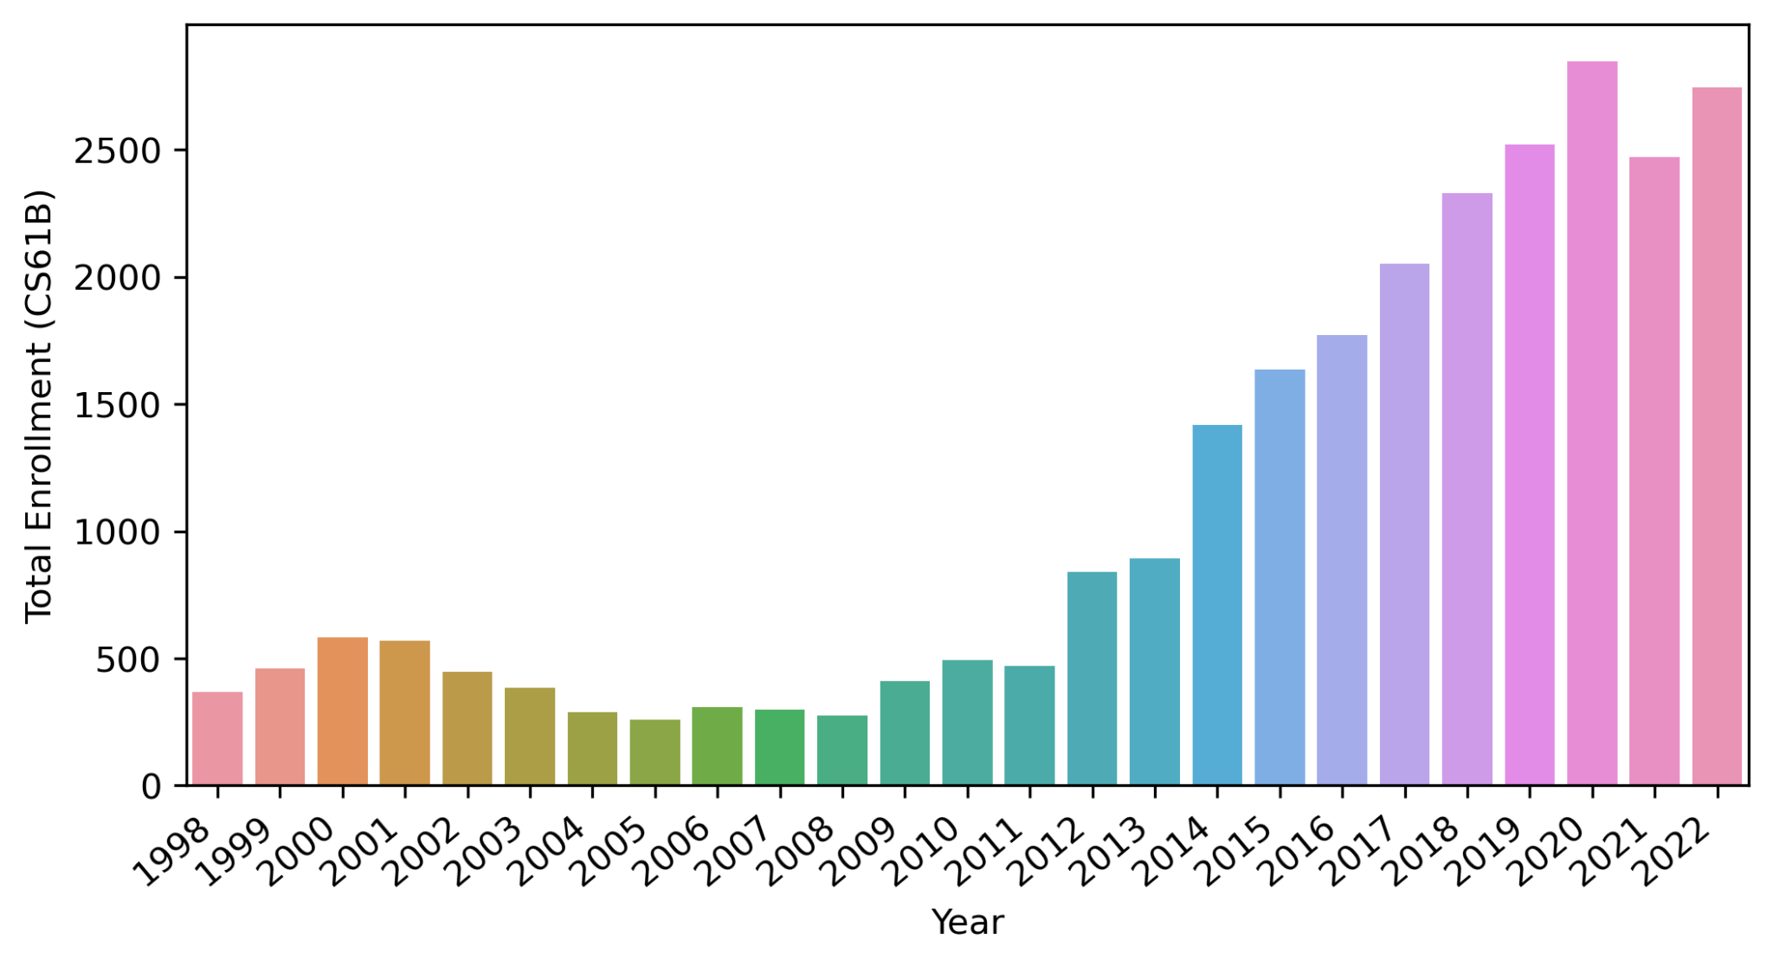
Why Study Algorithms or Data Structures?
Fa22

Slide 5
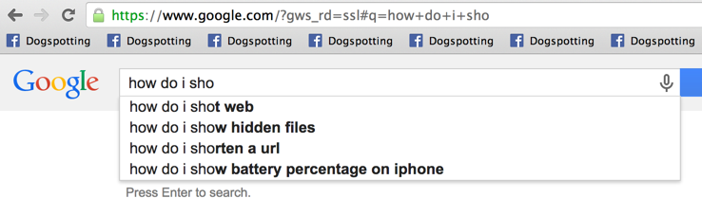
Why Study Algorithms or Data Structures?
Daily life is supported by them.

Slide 6
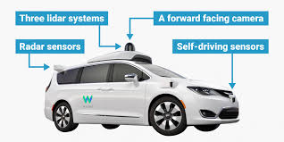
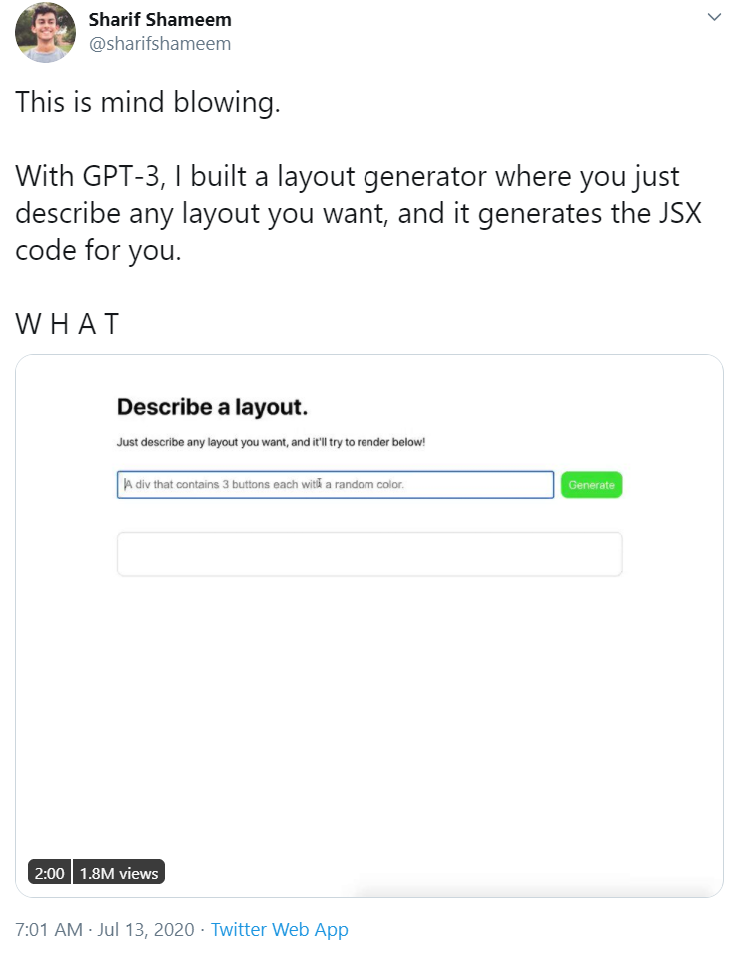

Why Study Algorithms or Data Structures?
Major driver of current progress (?) of our civilization.
Link
Notes:
http://www.businessinsider.com/how-does-googles-waymo-self-driving-car-work-graphic-2017-1
https://twitter.com/sharifshameem/status/1282676454690451457?lang=en

Slide 7
Why Study Algorithms or Data Structures?
To become a better programmer.
Being an efficient programmer means using the right data structures and algorithms for the job.
“The difference between a bad programmer and a good one is whether [the programmer] considers code or data structures more important. Bad programmers worry about the code. Good programmers worry about data structures and their relationships.” - Linus Torvalds (Creator of Linux)

Slide 8

Why Study Algorithms or Data Structures?
To understand the universe. Science is increasingly about simulation and complex data analysis rather than simple observations and clean equations:

Slide 9



Why Study Algorithms or Data Structures?
to
create
beautiful
things

Slide 10
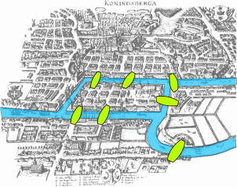

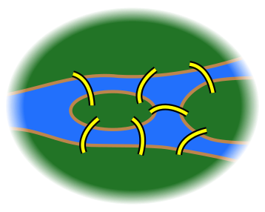
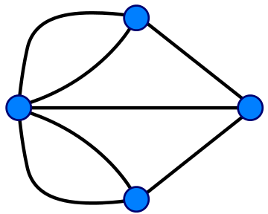
Why Study Algorithms or Data Structures?
As an end unto itself.
Possible to draw without picking up pencil or going back over any lines.
Impossible.
Notes:
http://members.ozemail.com.au/~macinnis/scifun/house.gif
Euler path: Must have exactly zero or two nodes of odd degree.

Slide 11
Question for You
What do you hope / expect to learn from this class? Why are you taking it?
Requirement for the major.
Intro to application.
For fun.
Learn Java.
immersive websites - this is an interesting one, because we won’t learn this at all, however we will learn a set of practices so that when youg et ot building websites, your project doesn’t collapse under its own complexity.
You shuold learn TypeScript it is a good language.
Designing a Database (though 186 the direct succesosr to this class is where you’ll really learn this)
Useful for jobs.

Slide 12
Who Are You?
(Note to Zoom Viewers, in the future I’ll be using Google Forms when asking questions out loud, but for today, I’m just asking the in person folks for a show of hands).
Notes:
Freshman? Sophomore? Junior? Senior? Grad student? None of the above?
CS Major? Intending to be a CS Major? Something else?
61A? Java experience?

Slide 13
Who Are We?
Instructor: Josh Hug (me) hug@cs.berkeley.edu 779 Soda
GSIs:
Full time
Ethan Ordentlich, Jedidiah Tsang, Sreevidya Ganga, Alex Schedel, Allen Gu, Anton Zabreyko, Aram Kazorian, Crystal Wang, Nandini Singh, Shreyas Kompalli, Todd Yu, Zephyr Barkan
Part time
Alexander Lew, Angelina Songco, Anish Bajaj, Claire Lee, David Lee, Dominic Conricode, Edward Park, Jasmine Lin, Kyle Zhang, Lucy Lu, Noah Adhikari, Richa Kotni, Ryan Nuqui, Sadia Qureshi, Samuel Berkun, Sherry Fan, Shreyas Kallingal, Ted Lin
We will also have a large number of academic interns (300 applications so far!)

Slide 14
Who Are We? (continued)
Academic interns:
Add Once Names Are Available

Slide 15
Learning Philosophy

Slide 16
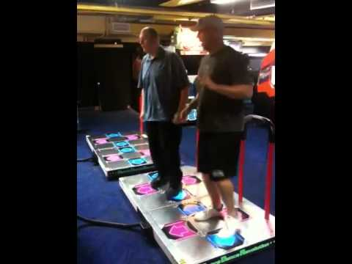

The Manner in Which Learning Occurs (TMWLO)
Notes:
12 minutes to reach this point (16 with new stuff)

Slide 17
TMWLO
Small minority of your learning:
Introduction to new material: Lectures / reading.
The vast majority of your learning:
Theory: Discussion sections, study guides, theory homework.
Programming, Tool Usage, Problem Decomposition: Labs, coding HW, projects.
Design: Projects 2 and 3.

Slide 18
Course Logistics

Slide 19
Places to Get Information
Official Course Resources
Course website: http://datastructur.es
Lectures. Discussion. Lab. Office Hours.
Ed Discussions: https://edstem.org/us/courses/25377/discussion/
Mini-Textbook: Obscurantism in Java https://joshhug.gitbooks.io/hug61b
Relevant readings linked on course website.
Unofficial: Google, Stack Overflow, other programming courses on the web, various online documentation, etc.

Slide 20
Logistical Details
For waitlisted folks: If you do project 0, I’ll do what I can to get you in by week 4, but no guarantees.
We should be able to accommodate everyone, but I can’t 100% promise.
If you are an interested grad student, I’m trying to see if I can open the class to you. No idea if I will be successful.
Go to any section or lab you want.
Please post administrative issues to Ed or send an email to cs61b@berkeley.edu
Please don’t email me with such issues directly (sorry!).
1200 students * 1 minute/student = 20 hours.

Slide 21
61B 4.1 - Course Structure
Phase 1: Programming Intensive Introduction to Java.
Weeks 1-4, Lectures 1 - 11.
Two homeworks:
HW0 (optional): Browser-based programming HW.
HW1: Being a good classmate.
Four labs to introduce you to various tools (starting this week).
Two projects (proj0 and proj1).
Midterm. Tentative date: September 14 at 7 PM.
Covers content through lecture 7 (Array Based Lists).

Slide 22
61B 4.1 - Course Structure
Phase 2: Data Structures.
Weeks 5-10.
Incredibly important and foundational material: Expect an CS job interview to lean heavily on this part of the course.
One programming HW (HW2) and one exam-prep theory HW (HW3).
Applications and deeper insight into data structures.
One large solo data structures project (Proj 2) (Checkpoint: 10/14, due 10/28).
Labs:
Lab 5: Peer review on project 1.
Two labs that implement data structures (hash table and BST).
Remaining labs are focused on project 2.
Midterm, tentative date: 10/19 at 7 PM.

Slide 23
61B 4.1 - Course Structure
Phase 3: Algorithms and Software Engineering.
Weeks 10-14
Project:
Proj 3: Build Your Own World: An open ended project where you and a partner build a 2D world with physics according to your own design. Due during lab in the last week of the class.
Labs devoted to project.
One theory homework due 12/05.
See calendar at http://datastructur.es for more.

Slide 24
Labs and Discussion
Attendance for lab/discussion is not required.
Labs:
Lab always due by Friday at 11:59 PM.
Full credit possible even without finishing entire lab.
Exact amount varies from lab to lab, determined by autograder.
Only have to pass some of the autograder tests for full credit.

Slide 25
Collaboration Policy
Collaboration:
You will submit your own solution to all HWs, all labs, and projects 0, 1, and 2.
For project 3, you must have a partner (with rare exception).
All code on solo projects, HWs, labs must be your own work.
Ok to discuss with others and help debug.
Common mistakes: Looking at someone else’s solution for “tips”. Having someone help “debug” huge swaths of code. These often result in overcollaboration.
Cite your sources! (including AI code generation tools).
There are more details on the course website. You are responsible for knowing these policies!

Slide 26

Weekly Surveys and Study Guides
Weekly survey due every Monday.
Check in on your progress and report attendance.
Free points, but no late submissions allowed!
Lowest four dropped.
Study guides for each lecture.
Provides a brief summary of the lecture.
Provides (usually) problems of varying difficulty for exam studying.
Hardest problems will even give TAs (or me) a hard time, so be nice!
Study guide includes a check-in exercise. No credit, but useful!

Slide 27
Exams
Exams are in-person (with remote exceptions). All exams in Pacific time.
Closed note except you can bring cheat sheets.
Will be pretty hard (60-65% medians).
Showing improvement on final can boost overall exam score.
If your final is statistically better, it can replace both of your midterms. See “percentile clobbering” under course website for details.
Exam dates:
Midterm 1: September 14th at 7 PM. Will accommodate conflicts/remote.
Midterm 2: October 19th at 7 PM. Will accommodate conflicts/remote.
Final Exam Times: December 15th, 3 - 6 PM.
Alternate exam policy to be determined:
Will definitely accommodate direct conflict with an exam in another class.

Slide 28
Course Grade
Breakdown: 25,600 points total. Letter grade will be determined by your total.
Midterms: 6400 points total.
Final: 6400 points.
Projects: 8960 regular points.
HW: 1920 points (480 points each)
Lab: 1280 points (128 points each)
Weekly Surveys: 640 points (64 points each)
Grades are not curved, i.e. they are not based on your relative performance. In past semesters, my grade bin cutoffs have not moved much at all.
See http://fa22.datastructur.es/about.html for full details including grading bin cutoffs (values not chosen yet, but will be by week 3).
Plus extra credit for filling out pre-, mid-, and post- semester course surveys.
Plus extra credit for project checkpoints.
Plus extra credit for project stretch goals.
Notes:
26 minutes

Slide 29
Lateness
No late work will be accepted in the course. No hws/labs/projects are dropped.
You should treat the deadlines seriously!
If needed, use automated extension system to use slip tokens.
Up to 9 total slip days.
Maximum of 4 per assignment.
Don’t expect similar extensions in other classes. 61B is not as strongly cumulative as classes like EE16A or CS70.

Slide 30
Course Pacing
We will start off very fast (and we’ll slow down in the last 4 weeks).
Optional HW0 is out.
Intro to Java syntax.
Will take 1-4 hours.
Work with friends!
Recommended that you complete before your lab.
Strongly recommended that you complete by lecture Friday.
Lab1 is available in two parts:
Lab1 Setup: How to set up your home computer (do before lab1).
Lab1: How to use various tools.
Project 0 released Friday. Due Friday Sep 2nd (10th day of the semester).
Start by Saturday if possible, especially if you’re new to Java.
Exercises basic Java features.
Full credit requires solving a very challenging algorithmic problem.

Slide 31

Hello World
(See guide for link to the code I write today)
(Might be a little boring if you know Java already)

Slide 32
Java and Object Orientation
Java is an object oriented language with strict requirements:
Every Java file must contain a class declaration*.
All code lives inside a class*, even helper functions, global constants, etc.
To run a Java program, you typically define a main method using public static void main(String[] args)
*: This is not completely true, e.g. we can also declare “interfaces” in .java files that may contain code. We’ll cover these later.

Slide 33
Java and Static Typing
Java is statically typed!
All variables, parameters, and methods must have a declared type.
That type can never change.
Expressions also have a type, e.g. “larger(5, 10) + 3” has type int.
The compiler checks that all the types in your program are compatible before the program ever runs!
e.g. String x = larger(5, 10) + 3 will fail to compile.
This is unlike a language like Python, where type checks are performed DURING execution.

Slide 34
Your Reflections on Static Typing
What are some good things about static typing?
What are some bad things about static typing?

Slide 35
My Reflections on Static Typing
The Good:
Catches certain types of errors, making it easier on the programmer to debug their code.
Type errors can (almost) never occur on end user’s computer.
Makes it easier to read and reason about code.
Code can run more efficiently, e.g. no need to do expensive runtime type checks.
The Bad:
Code is more verbose.
Code is less general, e.g. had to have two different larger functions earlier.

Slide 36
What’s Next
This week:
HW0: Out now. Will give you a chance to explore Java basics on your own.
Lab1: How to compile and run code. How to check out homework starter files and submit them. If possible, do HW0 before lab!
Do lab 1 setup before coming to lab: How to compile and run code on your own machine.
Project 0 (released Friday). Must be done solo.
Next lecture: What all that public static blah blah stuff actually means.
Note I will be at the front of the room for the next 3 minutes but then I am leaving to let the next person come set up in the room.

